Slide 1
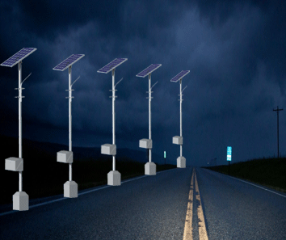
CENTRALIZED MONITORING SYSTEM FOR STREET LIGHT FAULT DETECTION AND LOCATION TRACKING

Slide 2







Slide 3

PROBLEM STATEMENT

Slide 4

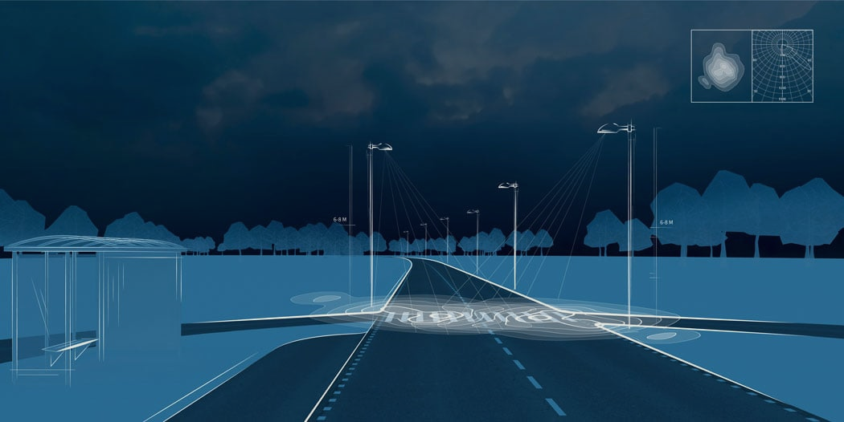
PROBLEM STATEMENT
Develop an innovative solution to automate real-time detection of street light faults, accurately identify fault types, and precisely track their locations. This system aims to streamline maintenance processes, reduce costs, and enhance the efficiency of street light management in Indian cities, ultimately improving service quality and governance.

Slide 5

PROPOSED SOLUTION

Slide 6
PROPOSED SOLUTION
Finding the faulty street light automatically is become a vital milestone by using this technology. The primary goal of the project is to provide control and identification of the damaged street light automatically. The lighting system which targets the energy and automatic operation on economical affordable for the streets and immediate information response about the street light fault. In general, the damage of the street light is observed by getting the complaints from the colony (street) people. Whereas in this proposed work using sensors these lights working status is easily captured without any manual interaction. So that it reduces manual efforts and the delay to fix problems. So, to reduce such problem we come with the solution wherein automatic detection of street light issues i.e.; whether the street light is working or not will be found at night time and it should send the notification to the authorized person if there is a problem in particular streetlight and also the location of the place where the streetlight is damaged. The street lights are automatically ON/OFF using IoT. In this system, it checks whether the street light is ON/ OFF. The LDR sensor will ON/OFF the street lights automatically, based on the condition of the weather.

Slide 7

TECHNICAL APPROACH

Slide 8
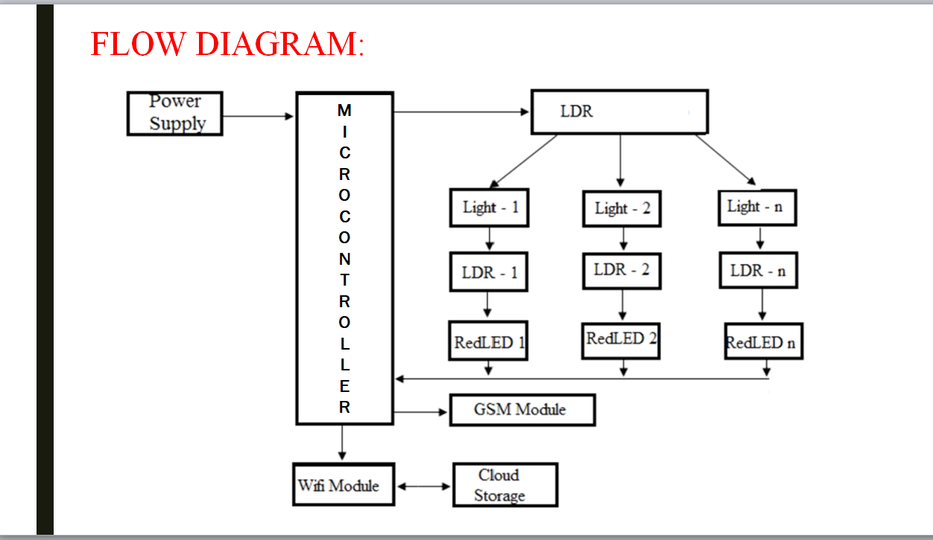

Slide 9


TECHNICAL APPROACH

Slide 10

KEY FEATURES
&
FUNCTIONALITY

Slide 11
KEY FEATURES & FUNCTIONALITY
REMOTE MONITORING AND CONTROL: Smart street light systems allow operators to remotely monitor and control individual or groups of street lights. This enables real-time adjustments to lighting levels, on/off scheduling, and immediate response to faults.
AUTOMATIC FAULT DETECTION: The primary function is to automatically detect and report faults in street lights. Common faults include burnt-out bulbs, damaged fixtures, and electrical issues. Detection can be done using sensors, such as light-level sensors, motion detectors, or cameras.
ENERGY EFFICIENCY: Smart systems can adjust the brightness of street lights based on ambient light levels and traffic patterns. This results in energy savings, as lights can be dimmed or turned off when not needed.
MAINTENANCE ALERTS: The system generates alerts when it detects faults, allowing maintenance crews to respond proactively. This reduces downtime and improves public safety.
DATA ANALYTICS: Collecting data on street light performance and energy usage allows for in-depth analytics. This data can be used to optimize energy consumption, predict maintenance needs, and plan future infrastructure improvements.
GEOLOCATION AND MAPPING: Smart street light systems often incorporate GPS or GIS technologies, enabling precise location information. This is useful for pinpointing faults and planning maintenance routes.

Slide 12
USER EXPERIENCE
DASHBOARD OVERVIEW: Provide an overview of the entire street light network, with a map displaying the location of each street light. Use color coding or symbols to indicate the status of each light (e.g., green for operational, red for faults).
ALERTS AND NOTIFICATIONS: Implement a robust notification system. Users should receive real-time alerts when a fault is detected, such as via email, SMS, or push notifications. Include details like the location of the fault and the nature of the problem.
Fault Details: When a fault occurs, users should be able to click on a specific street light to get detailed information about the issue. Include error codes, maintenance history, and expected repair time.
HISTORY AND ANALYTICS: Provide historical data and analytics on street light faults. Users can access reports on fault trends, maintenance costs, and performance metrics. This can help in making informed decisions about maintenance schedules and budget allocation.
User Roles and Permissions: Implement role-based access control. Different users (e.g., maintenance teams, city officials, technicians) should have varying levels of access and control over the system.
GPS INTEGRATION: Use GPS to pinpoint the exact location of each street light. This feature makes it easier for maintenance crews to locate and address issues quickly.

Slide 13
Smart street lights with fault detection can offer several benefits to government authorities and municipalities. Here are some of the advantages and use cases:
ENERGY EFFICIENCY: Smart street lights can automatically adjust their brightness based on real-time conditions, such as ambient light levels, traffic density, and weather. This leads to significant energy savings and reduced operational costs for the government.
COST REDUCTION: Street light faults can be detected in real-time, allowing for quick maintenance and repair. This minimizes downtime and reduces the cost of emergency repairs, ultimately saving government funds.
REMOTE MONITORING: Fault detection systems can provide authorities with real-time data on the status of street lights across the city. This remote monitoring enables quick responses to faults, reducing dark areas and enhancing overall safety.
REDUCED LIGHT POLLUTION: Smart street lights can be dimmed or turned off when not needed, reducing light pollution and its associated environmental and health concerns.
SAFETY: Timely fault detection enhances public safety by ensuring that all areas remain well-lit. This can help prevent accidents, reduce crime, and create a safer environment for citizens.
BUSINESS/ IMPACT POTENTIAL

Slide 14
FUTURE DEVELOPMENT
&
ENHANCEMENT

Slide 15

FUTURE DEVELOPMENT &
ENHANCEMENT
AI AND MACHINE LEARNING INTEGRATION: Incorporate AI and machine learning algorithms for predictive maintenance. These algorithms can analyze historical data to predict when a street light is likely to fail, allowing for proactive maintenance.
EDGE COMPUTING: Implement edge computing devices within each streetlight. This would enable real-time fault detection and reporting without relying solely on centralized systems. It can also reduce latency and improve overall system efficiency.
ENVIRONMENTAL SENSORS: Enhance smart street lights by integrating environmental sensors. These sensors can monitor air quality, temperature, humidity, and other environmental parameters. This data can be used for pollution monitoring and climate control.
TRAFFIC AND PEDESTRIAN MONITORING: Expand the capabilities of smart street lights to include traffic and pedestrian monitoring. This information can be used for traffic management, crowd control, and improving safety.
WIRELESS COMMUNICATION: Upgrade the communication infrastructure to use low-power, long-range wireless technologies such as LoRaWAN or NB-IoT. This can improve connectivity and reduce power consumption.

Slide 16
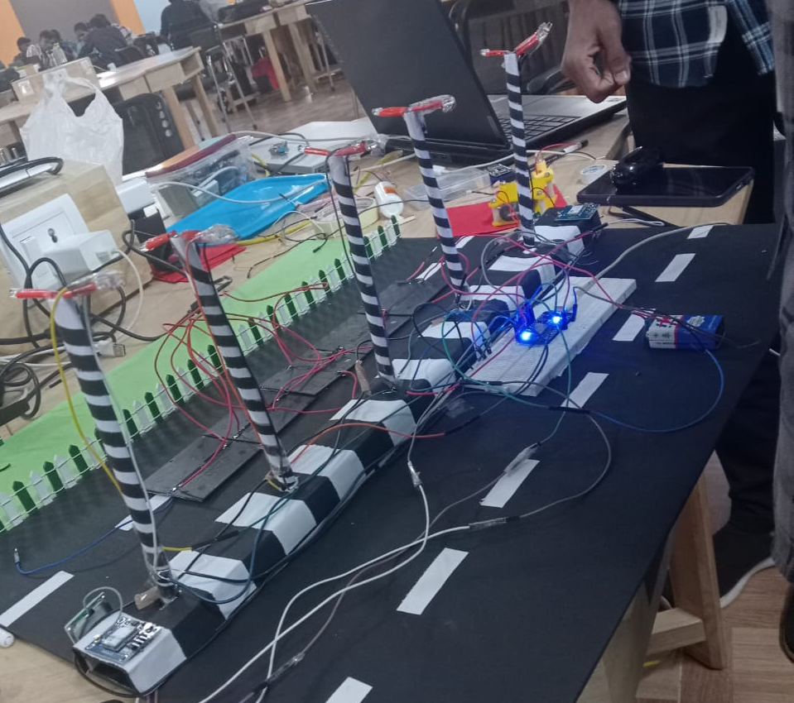
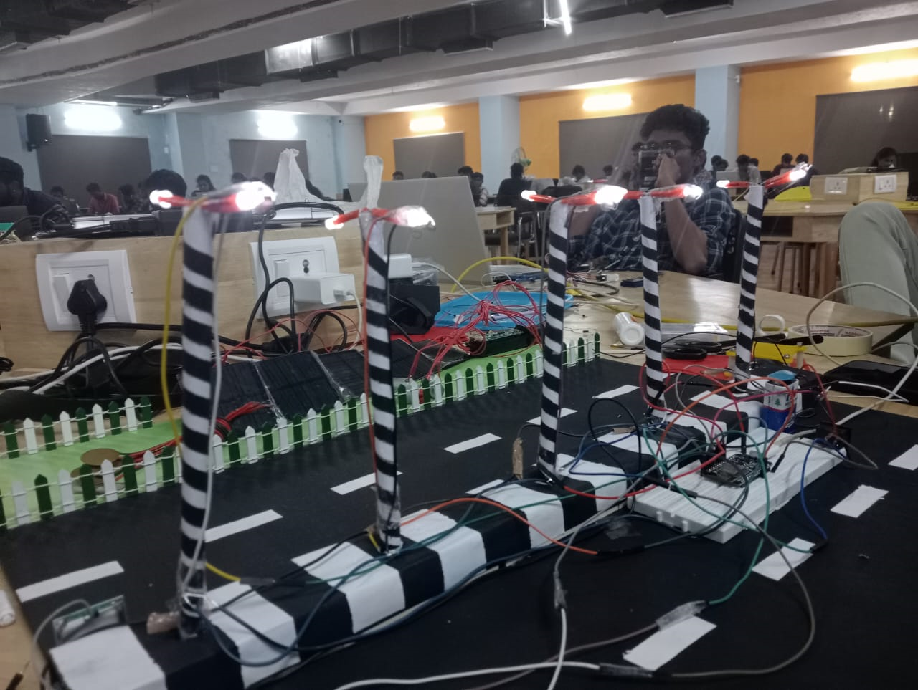
OUTPUT

Slide 17


